Slide 1

AH-VEST
Social and Ethics Committee
Meeting 19th March 2025

Slide 2


Labour and Employment
OUR STANDING ON ILO PROTOCOLS
AH-VEST supports and adheres to the terms of the International Labour Organization Protocol. This is supported by the Audit that was done by DOL National Office for Basic Conditions of Employment Act Compliance.

Slide 3

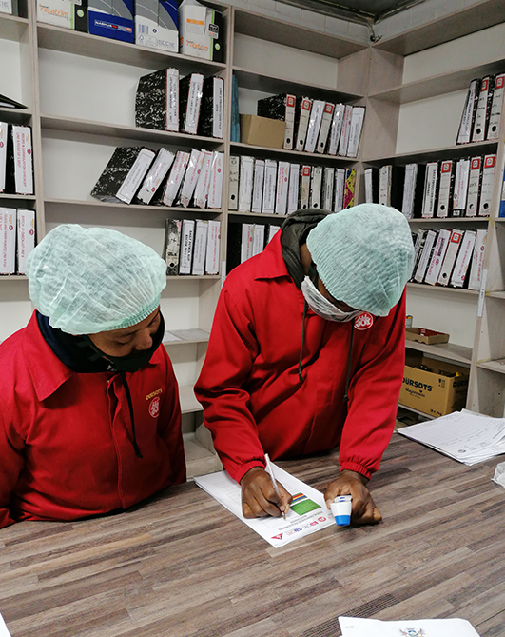
OUR STANDING ON ILO PROTOCOLS
The company complies with laws and regulations related to Labour standards such as minimum wage, working hours and occupational health and safety. AH-Vest application for Minimum wage exemption was granted.
The company respect worker’s rights , including freedom of association and collective bargaining.
The company is transparent in its Labour practices and accountable for any Labour related violations.
The company respect its employees and do not practice child Labour or forced Labour.
AH-VEST is compliant with the following Acts:
Basic Conditions of Employment Act No.75 of 1997.
Labour Relations Act No.66 of 1995.
Skills Development Levies Act No.9 of 1999
Unemployment Insurance Act No.63 of 2001

Slide 4
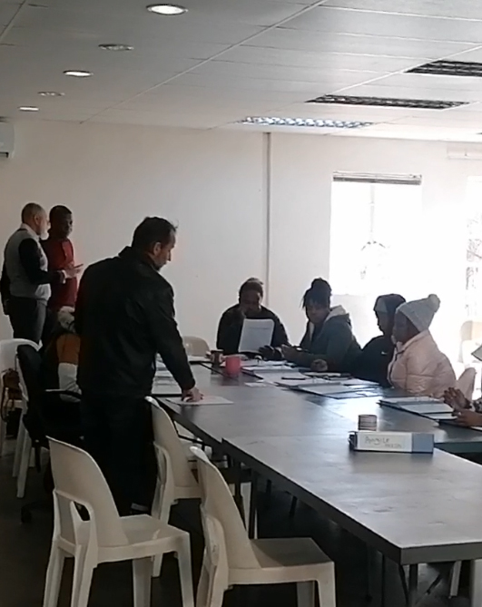
EDUCATIONAL DEVELOPMENT OF EMPLOYEES
AH-VEST promotes mentorship and coaching of employees internally to ensure knowledge enhancement. Employees are promoted internally and respective supervisors' mentor and coach them until when they can efficiently and effectively excel their respective departments.
AH-VEST also offers internship programs for apprenticeships, it has partnership with Mectom Skills Development and every year AH VEST accommodates about 15 students for Electrical and Mechanical disciplines for 12 months to help them acquire practical skills and gain industry insights.
AH-VEST offers learnership programs through Food Bev Seta, however in the past year there was no training due to various changes taking place at SETA whereby all learnerships are now managed by QCTO.

Slide 5
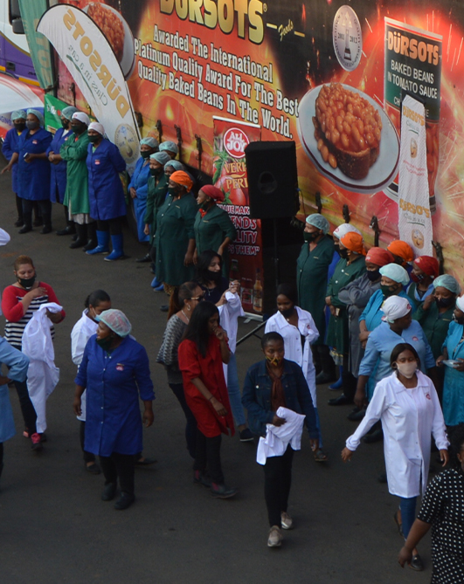
BROAD-BASED BLACK ECONOMIC EMPOWERMENT & EMPLOYMENT EQUITY
AH-VEST acquired level 2 Contributor with the highest performance on Enterprise and Supplier development. It is valid until the 18th of September 2025.
Employment Equity
We were placed under the Director General Review and had DOL for Employment Equity had on-site visit end of October and the recommendation was to review our targets and goals.
It was noted that there was under representation and over representation of various groups and there was need to strike a balance.
We submitted the report as per GD recommendations and it was approved and was implemented in our current EE submissions that were done in December 2024.

Slide 6

SAFETY, HEALTH AND QUALITY
AH-VEST subscribes to and is compliant with the Occupational Health and Safety Act as well as the Food Safety Standards.
Safety
AH VEST recorded zero workplace injuries or near misses in the past period and there is ongoing awareness trainings given to employees to minimize accidents.
AH-VEST is currently recruiting the Health and Safety Officer to replace the one who resigned.
The company conducted the annual Food Safety Audit during the period under review and achieved 90.2% score.

Slide 7
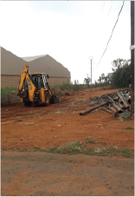

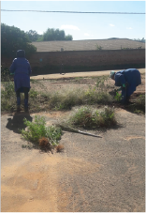
ENVIRONMENTAL PERFORMANCE
AH-VEST subscribes to and is compliant with the Occupational Health and Safety Act as well as the Food Safety Standards.
AH Vest is committed to minimizing its environmental footprint and maintaining a clean and healthy environment around the factory.
AH Vest aims managing its waste by engaging in recycling programs metal in order to reduce waste that is send to land fills.
Cleaning of the surrounding environment is an ongoing process to maintain a good environment.

Slide 8

HEALTH AND WELL-BEING
AH Vest engaged in various activities in trying to promote employee physical and mental health.
Employees celebrated heritage and youth day at the factory, and they were representing various cultures and competing amongst themselves. This was a good initiative to encourage team building and they requested this to be done every year.
AH Vest has implemented a physical wellness program by allowing its employees to play soccer and netball on Fridays during lunch to improve on their fitness.

Slide 9
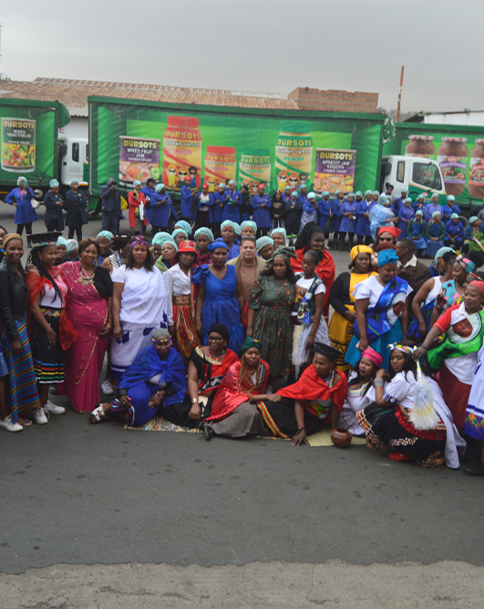
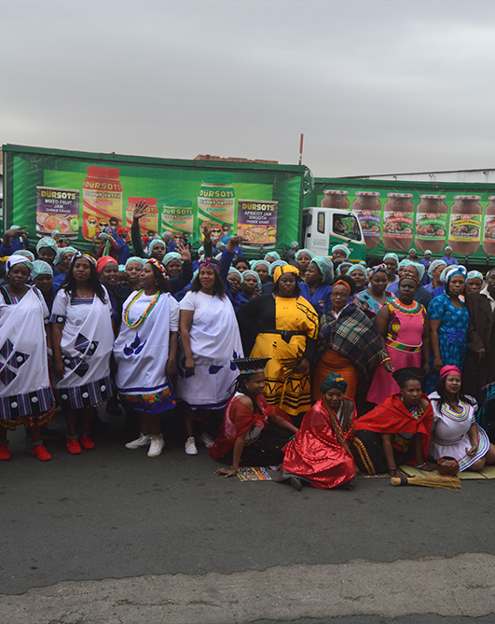
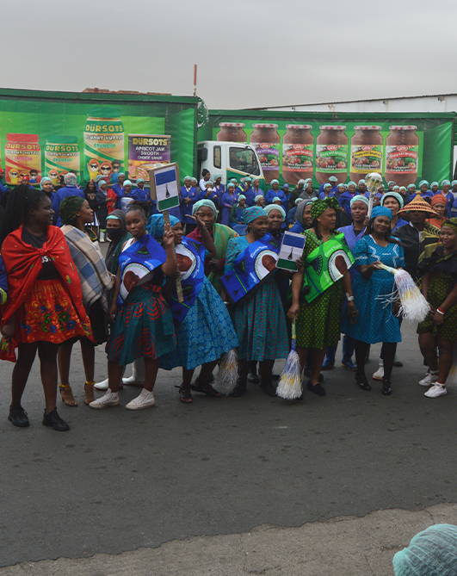
HERITAGE DAY 2024

Slide 10
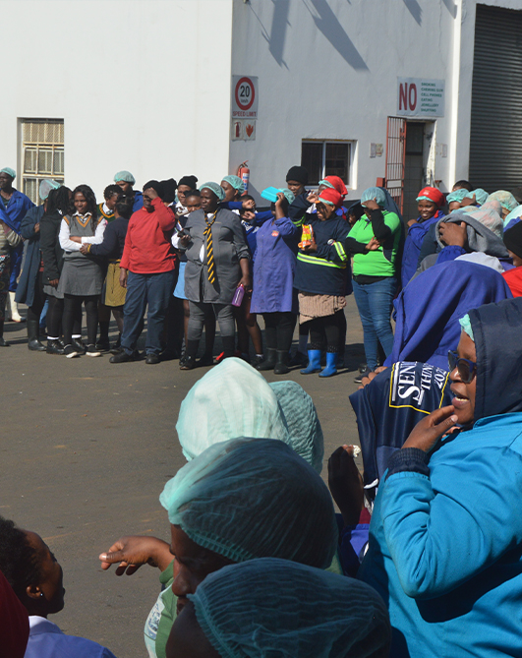


YOUTH DAY 2024

Slide 11

CORRUPTION AND FRAUD MATTERS
AH Vest has a zero-tolerance culture on fraud and corruption and there is a policy in place which outlines the expectations and consequences for employees.
The company continue to reduce risk of corruption and fraud by promoting a culture integrity and transparency.
CORPORATE COMPLIANCE PROGRAM
AH Vest is in compliant with its policies, procedures and ensure its monitoring and enforcement.

Slide 12

COMPLIANCE LAWS AND REGULATIONS
During the period September – November 2024, we’ve received the following inspections.
Department of Labour, Pretoria, for Occupational Health and Safety
Department of Labour and Home Affairs
Department of Labour Employment Equity
Department of Labour Basic Conditions of Employment

Slide 13

FOOD SAFETY
Food safety is a critical aspect of food manufacturing, and our company is committed to producing safe and high-quality products.
AH Vest follows good manufacturing practices to ensure that products are manufactured in a clean and safe environment. This is achieved through the following practices:
Cleaning and sanitation- there is regular cleaning and sanitation of equipment, utensils and production areas.
Personal hygiene- employees good personal hygiene practices by washing their hands and wearing proper clean protective clothing.
Pest control-the company has an effective pest control measure to prevent contamination.

Slide 14

FOOD SAFETY (CONTINUED)
Food Safety Training
The company provides internal training to employees to ensure that they understand the importance of food safety and their role in maintaining a safe and clean production environment.
Audits and Inspections
The factory undergoes regular audits and inspections by internal and external auditors to ensure compliance with food safety regulations and standards.
The company keep on trying to maintain a robust food safety management system to ensure compliance with food safety regulations and standards.

Slide 15

REPUTATION RISK
AH Vest has not reported on potential harm to an organization’s reputation , brand and image. Below is what the company has does to mitigate reputation risk
The company has a strong culture of ethics, integrity and transparency to prevent reputation-damaging behaviors.
Monitoring of social media and online reviews to quickly identify and respond to reputation damaging incidents.
The company engage with its stakeholders such as customers and regulators to build trust and maintain a positive reputation.
Reputation risks has various consequences for an organization such as financial losses, loss of customer trust, damage to brand and regulatory scrutiny which may lead to fines and penalties.

Slide 16

CRISIS COMMUNICATION
Crisis communication plan is a critical component of the organization’s crisis management strategy.
AH Vest has procedures and protocols for communicating with stakeholders during crisis , ensuring that the relevant team responds quickly, effectively and transparently.
The keys objectives are as follows:
Protect Reputation – protecting the company’s reputation by responding promptly and transparently to the crisis.
Maintain Trust – the company maintains stakeholder trust by providing accurate, timely and consistent information.
Ensure Safety – the company ensure safety of its employees, customers and the public by providing clear instructions and guidance.

Slide 17

CORPORATE SOCIAL RESPONSIBILITY
Corporate Social Responsibility integrates into our social and environmental concerns and into our operations and the interactions with stakeholders. AH- Vest Ltd is registered under the Securities and Exchange Commission (SEC) and maintain a record of their contributions towards community development.
This report provides an overview of CSR initiatives, the SEC register for CSR contributions, and details on sponsorships, donations, and charitable giving.
SEC Register for CSR Contributions
The SEC Register for CSR Contributions formally record and maintained documents financial and non-financial contributions aimed at community development.

Slide 18

CORPORATE SOCIAL RESPONSIBILITY
Key Elements Recorded In The Register:
DATE OF CONTRIBUTION
NAME OF RECIPIENT ORGANIZATION
TYPE OF CONTRIBUTION (FINANCIAL OR NON-FINANCIAL)
AMOUNT / VALUE OF THE CONTRIBUTION
PURPOSE OF THE CONTRIBUTION
GEOGRAPHICAL AREA OF IMPACT
EXPECTED OUTCOME AND BENEFITS

Slide 19

CORPORATE SOCIAL RESPONSIBILITY
Register of sponsorships, donations and charitable giving.
AH Vest register of sponsorships ,donations and charitable giving to track contributions towards social causes. The register includes:
Date | Reciepient | Type of Contribution | Amount
December 2024 | Crescent of Hope | Donation | R42 000
January 2025 | African Muslim Agency | Donation | R80 400
February 2025 | Various Schools | Donation | R54 625
January 2025 | Benoni Soup Kitchen | Donation
February 2025 | Thembisa Soup Kitchen | Donation

Slide 20

CORPORATE SOCIAL RESPONSIBILITY
AH-Vest Ltd social responsibility plays a critical role in the community development. We strategically plan their contributions and maintain transparency through proper documentation in the SEC Register for CSR Contributions and Sponsorship and Donations Register. These efforts help foster sustainable community growth while enhancing corporate reputation and regulatory compliance.
THE END

